Slide 1
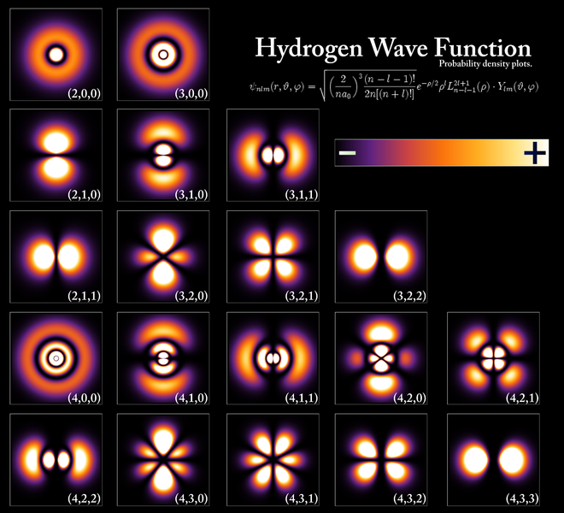
Lecture 8: Hydrogen atom wavefunctions

Slide 2
The Hydrogen atom SE in spherical polar coordinates
n = 1, 2, 3…
l < n
l=0,1,2,3…
|m|< l
m=0, ±1, ±2, ±3, ±4,….

Slide 3
Energy and Angular Momentum
n = 1, 2, 3…
l < n
l=0,1,2,3…
|m|< l
m=0, ±1, ±2, ±3, ±4,….

Slide 4
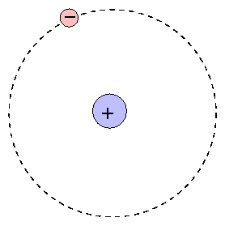
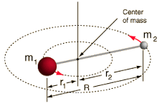
H-atom
Rigid rotor
(x_{e},y_{e},z_{e})
Two particle/mass central-
force problem
r_{en} variable
Model for di-atomics
Concepts from CM
Reduced mass
r constant

Slide 5
A rotating diatomic molecule
μ
r₀
Reduced mass: From two body to one body problem

Slide 6
Laplacian in Spherical Coordinates

Slide 7
Kinetic energy operator in Spherical Coordinates
Rigid rotor
Potential energy = 0
KE term: entire Hamiltonaian
r = constant
Derivative with respect to r = 0

Slide 8
Hamiltonian in Spherical Coordinates
Rigid rotor
Potential energy = 0
KE term: entire Hamiltonaian
r = constant
Derivative with respect to r = 0

Slide 9
Hamiltonian from square of angular momentum operator

Slide 10
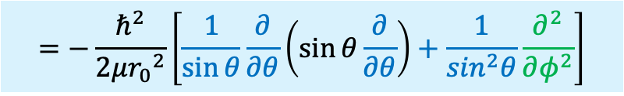
Hamiltonian from square of angular momentum operator
$$=−\frac{ℏ^{2}}{2μ{r_{0}}^{2}}\left[\frac{1}{\sin{θ}}\frac{∂}{∂θ}\left(\sin{θ}\frac{∂}{∂θ}\right)+\frac{1}{\sin^{2}θ}\frac{∂^{2}}{∂φ^{2}}\right]$$

Slide 11
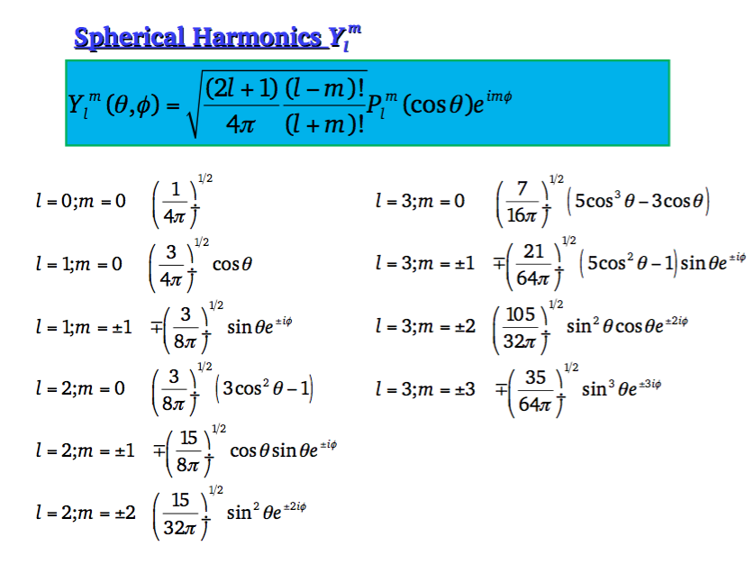

Slide 12
Radial Functions (of Hydrogen Atom)
Number of radial nodes =
n-l-1

Slide 13
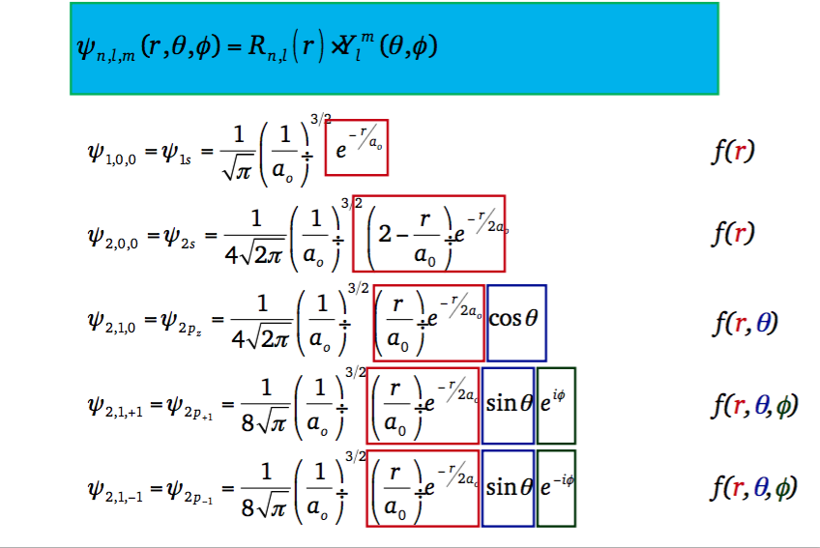
H-Atom Complete Ψ(r,θ,φ) for n=1,2
Note: R_{nl}→0 as r→infinity

Slide 14
H-Atom Complete Ψ(r,θ,φ) for n=1,2
1s and 2s Orbitals
Note: R_{nl}→0 as r→infinity
Functions of only ‘r’

Slide 15
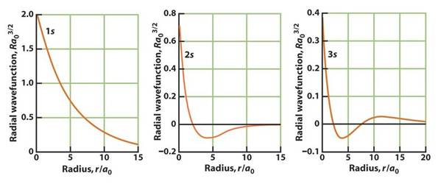
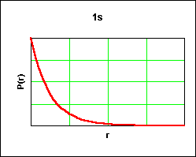
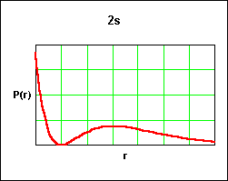
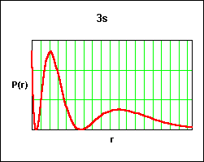
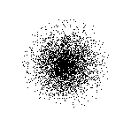
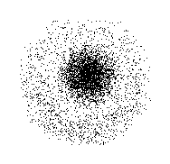
S-Orbitals (l=0,m_{l}=0)” R_{nl} and R_{nl}²
For s-Orbitals the maximum probability density of finding the electron is on the nucleus: Maximum probability of finding the electron?

Slide 16
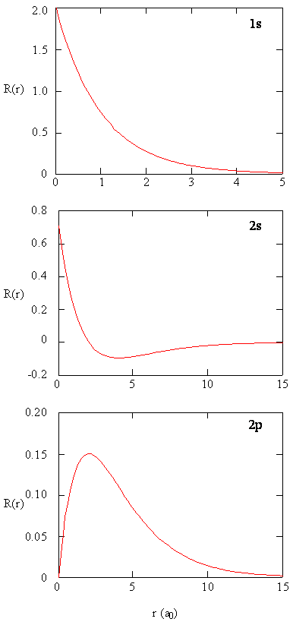
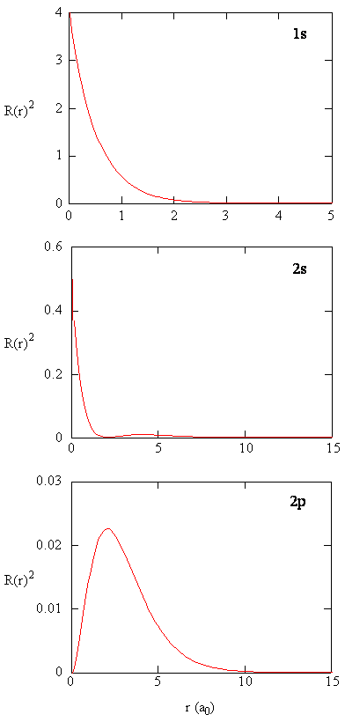
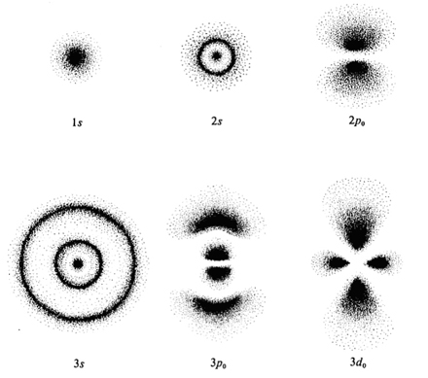
Radial functions
for H-Atom for n=1,2
For s-Orbitals the maximum probability density of finding the electron is on the nucleus
Maximum probability of finding the electron?

Slide 17
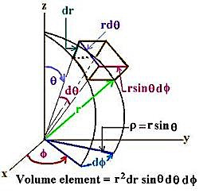

Probability: Volume element in spherical polar coordinates
For a s orbital
2
2π
Radial Probability distribution function

Slide 18
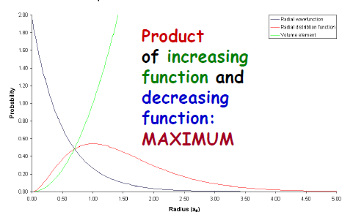
Radial Distribution Functions : Probability
For s-Orbitals :
Maximum probability density of finding the electron is on the nucleus
Probability of finding the electron on the nucleus zero

Slide 19
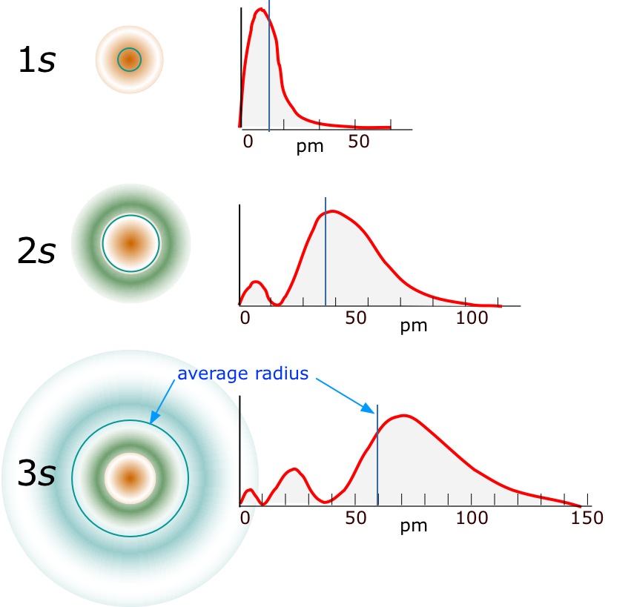
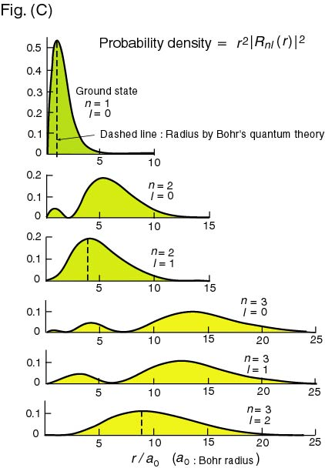
Radial Distribution Functions: 4πr²R_{nl}²(r)
Number of Radial Nodes
is always n-l-1
3s: n=3, l=0
Nodes= 2
3p: n=3, l=1,
Nodes= 1
3d: n=3, l=2
Nodes = 0
N=1, l=0
N=2, l=0
N=3, l=0

Slide 20
H-Atom Complete Ψ(r,θ,φ) for n=2
2p Orbitals
Functions of ‘r’, ‘θ’ and ‘φ’

Slide 21
2p Orbitals
Linear
combination

Slide 22
Radial functions
for H-Atom for n=1,2
2p Orbitals
For s-Orbitals the maximum probability density of finding the electron is on the nucleus

Slide 23
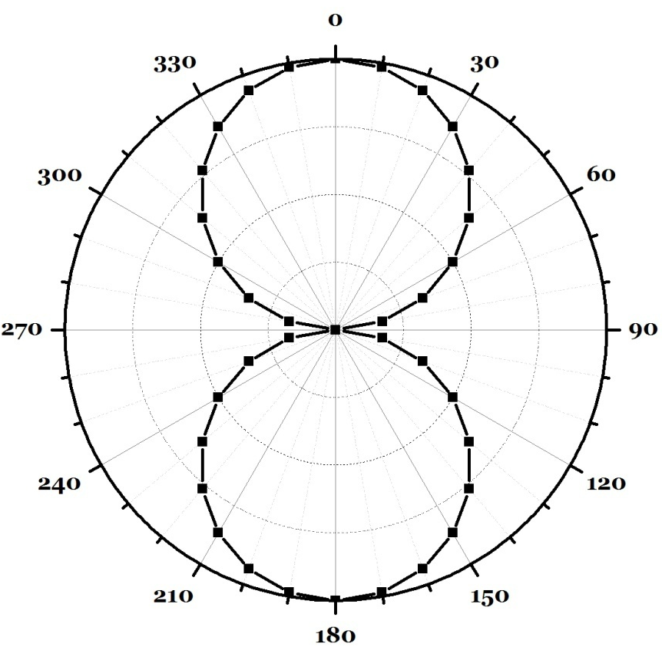
Angular Functions?
p-Orbitals
Angular part: Polar plot of 2p_{z} --- cosθ
θ | cosθ
0 | 1.000
10 | 0.985
20 | 0.940
30 | 0.866
40 | 0.766
50 | 0.643
60 | 0.500
70 | 0.342
80 | 0.174
90 | 0.000
120 | -0.500
150 | -0.866
180 | -1.000

Slide 24
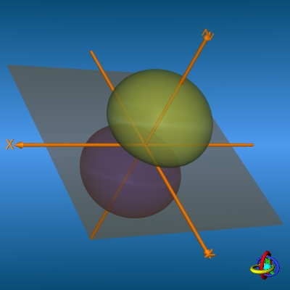
Complete Rotation around z-axis

Slide 25
Misinterpretation of Orbital pictures
Angular plots of Ψ(θ,φ) has no physical meaning – just mathematical functions - may be used to obtain information about probable electron distribution.
But can not be, in any way, regarded as the “picture” of an orbital. It is unfortunate that fuzzy drawings like these are often incorrectly represented as “orbitals”
However, ψ² might provide a better intuitive picture
Definition:“Orbital” is an 1-electron wavefunction

Slide 26
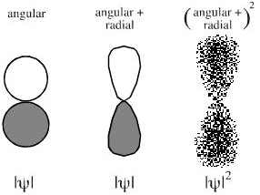
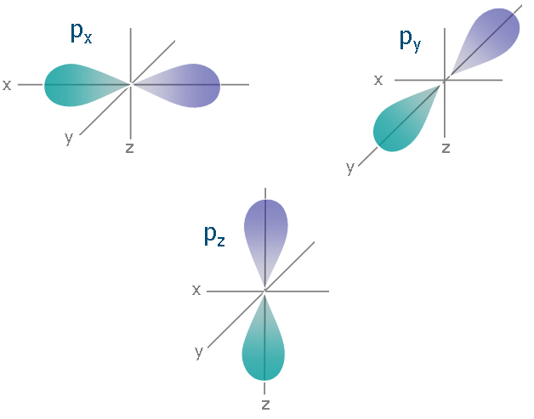
(Angular x Radial) Electron Densities
x
x

Slide 27
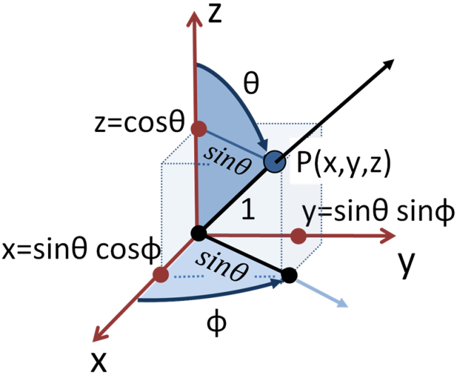
Basis for nomenclature of Orbitals

Slide 28
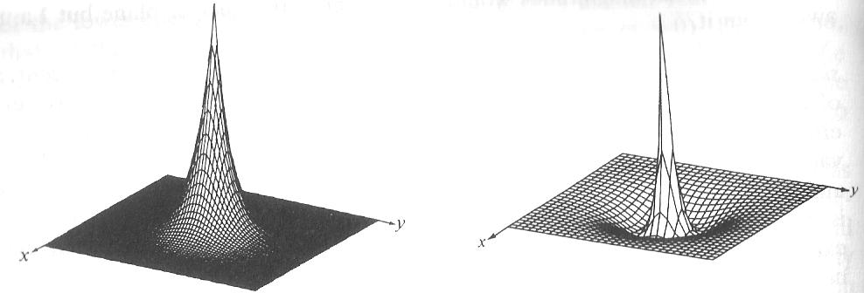
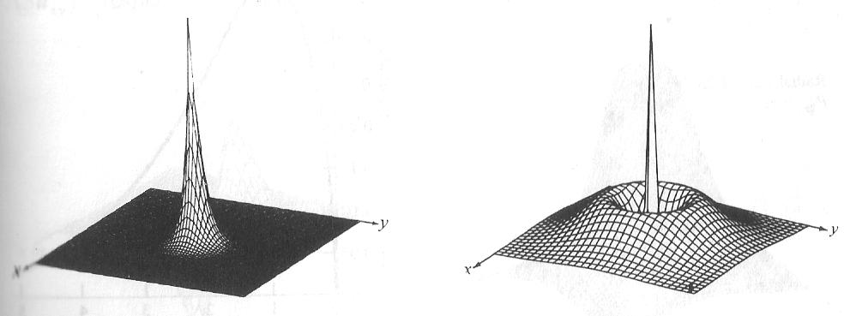
Surface plot of Ψ and Ψ² for S
1S
2S
(1S)²
(2S)²
Maximum probability of finding the electron?

Slide 29
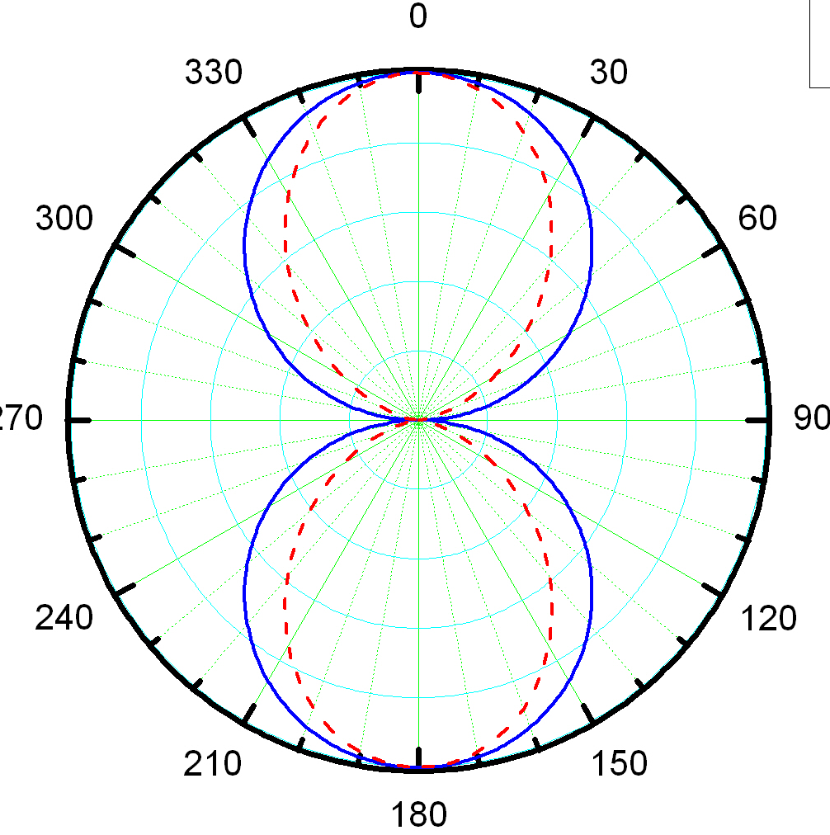
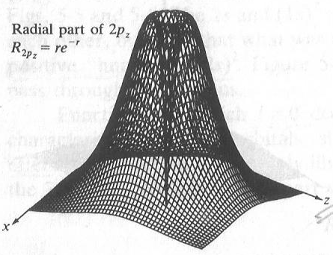
Surface plot of Ψ_{2pz} = (re^{-r})x(Cosθ)

Slide 30
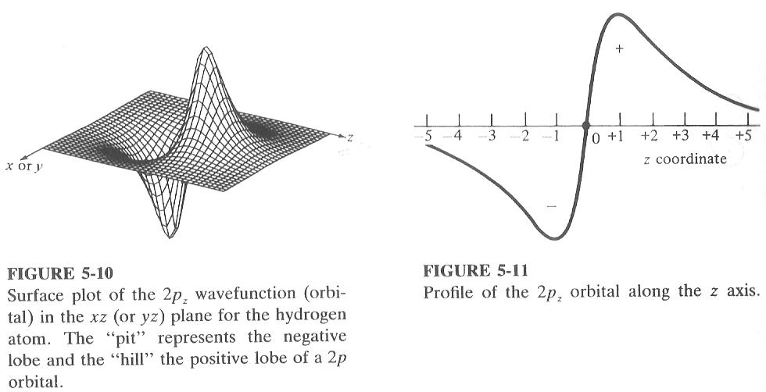
Surface plot of Ψ_{2pz} = (re^{-r})x(Cosθ)
One 3D projection
of 4 dimensional plot
(Φ is constant)
One cross section

Slide 31
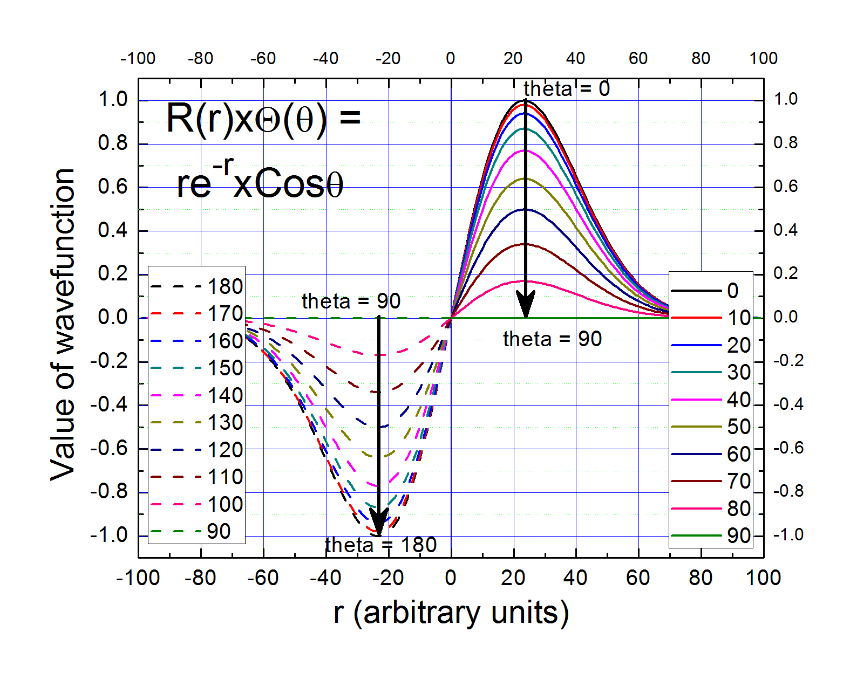

Slide 32
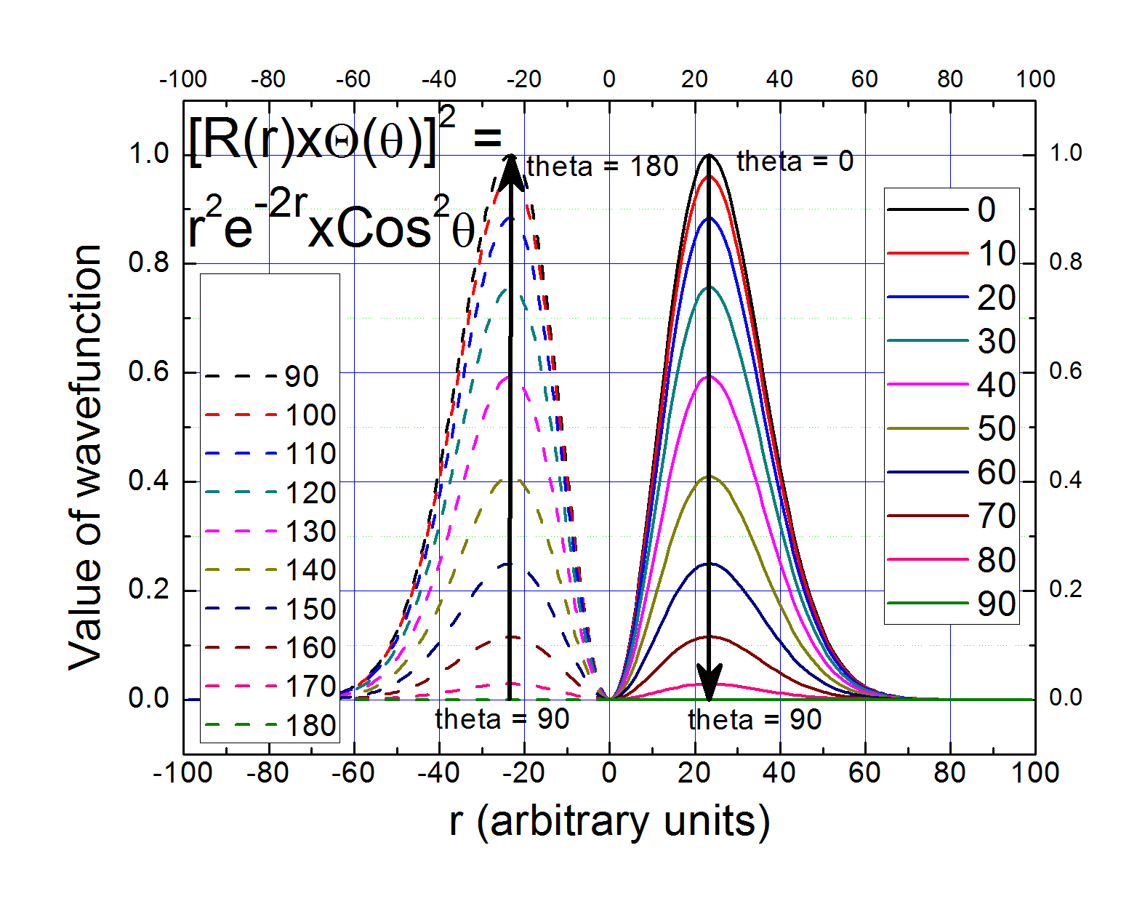

Slide 33
Surface plot of Ψ_{2pz} = (re^{-r})x(Cosθ)

Slide 34
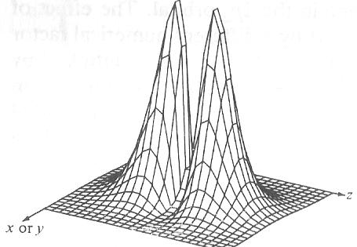
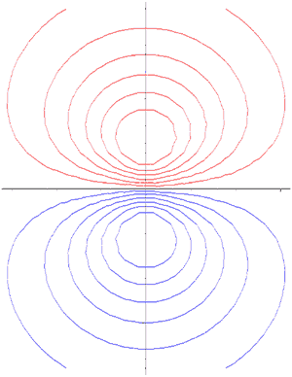
Surface plot of Ψ²_{2pz}~(r²e^{-2r})x(Cos²θ)
In books, or in class, one of the low valued
probability density contour are shows as “Orbitals”

Slide 35
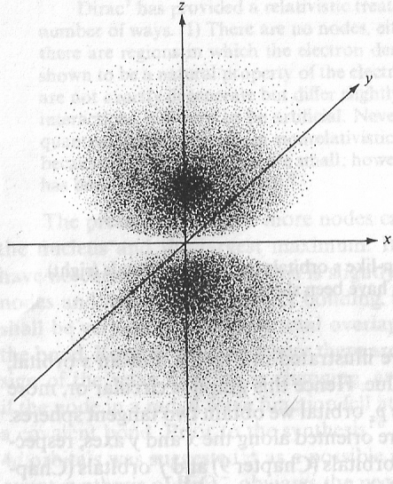
Contours of constant probability density → Distribution of electron density
An “Orbital” is a 1-e wavefunction

Slide 36
“Shapes” of orbitals depend
on Orbital quantum number l
and Magnetic quantum no. m_{l}
No φ dependence: symmetric around z axis
Number of Angular Nodes = l

Slide 37
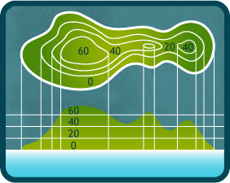
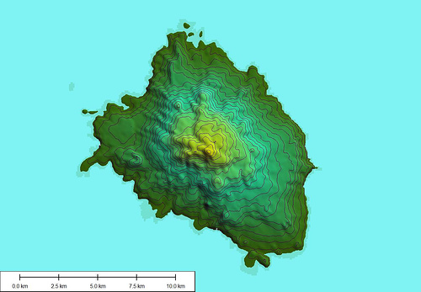
3D and contour representations

Slide 38
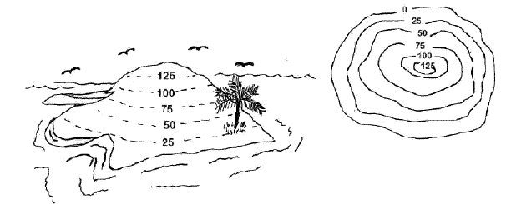
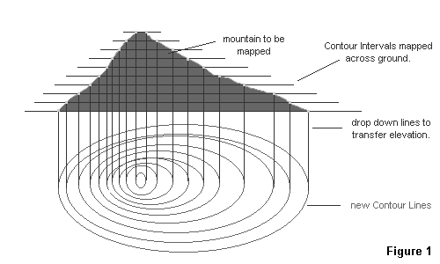
3D and contour representations

Slide 39
Contour representations of Orbitals with nodes : given their expression!

Slide 40
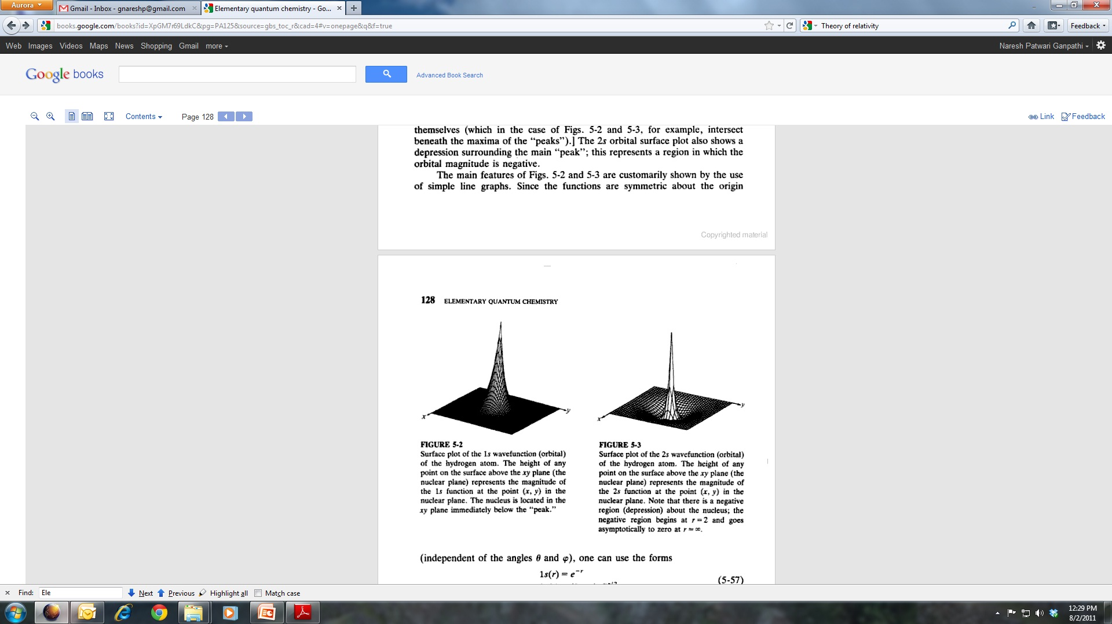
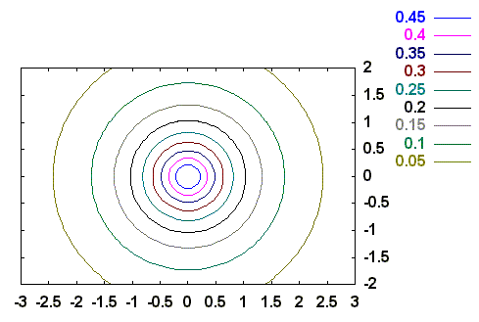
1s orbital

Slide 41
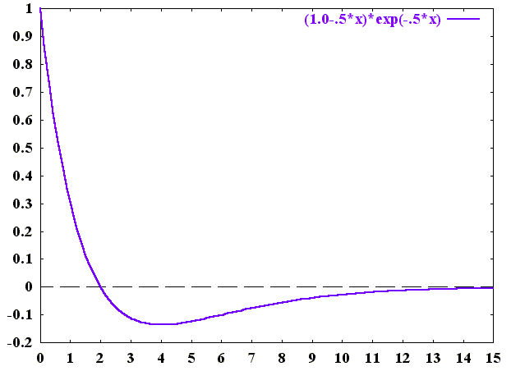
2s orbital
radial node
Y. U. Sasidhar

Slide 42
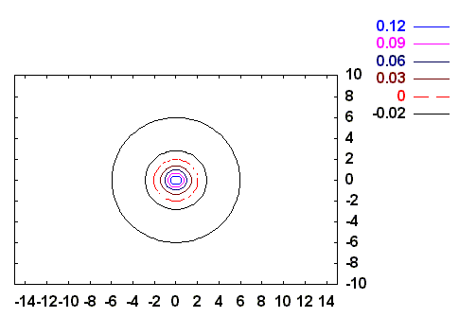
2s orbital
radial node
radial node
y/a
-
+
x/a
Y. U. Sasidhar

Slide 43
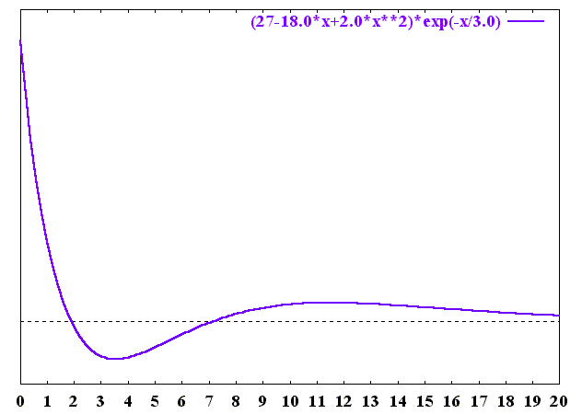
3s orbital
radial nodes
r/a

Slide 44
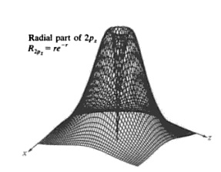
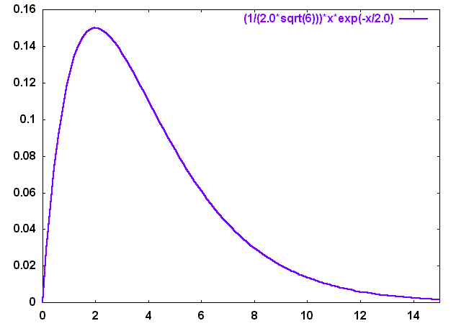
2p_{z} orbital
Angular Part
(2,1,0)
Radial Part starts with a zero at r=0; so does Ψ
No radial node !
Y. U. Sasidhar

Slide 45
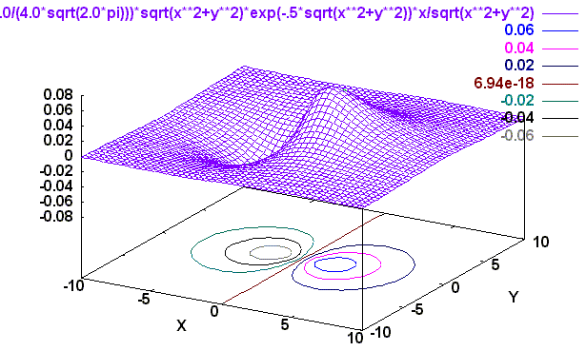
2p_{z} orbital
Angular Part
(2,1,0)
X
Z

Slide 46
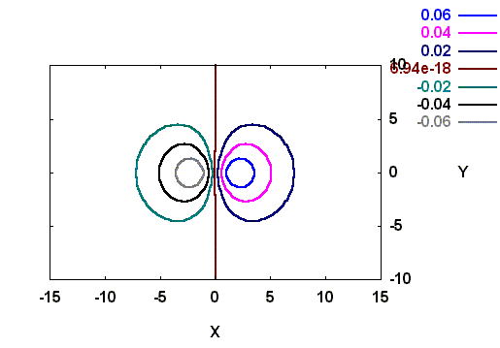
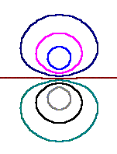
2p_{z} orbital
Angular node
z=0
same value
_
x/a
+
- ve contours
+ ve contours
z/a

Slide 47
2p_{z} orbital: Constant Probability Surface
+
_

Slide 48
2p_{z} orbital: Probability distribution as dots

Slide 49
2p Orbitals
Linear
combination

Slide 50
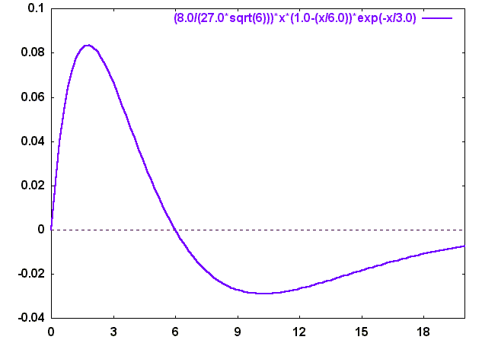
3p_{z} orbital
radial
node
R
r/a

Slide 51
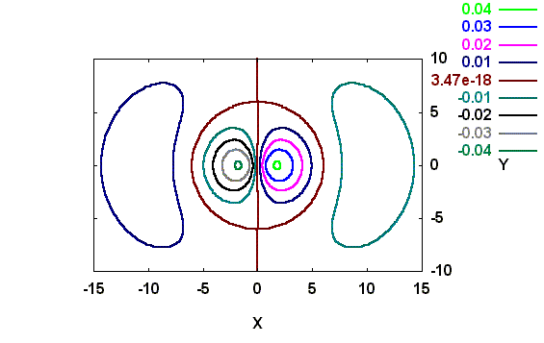

3p_{z} orbital
radial node
x/a
x/a
angular node
z/a
y=0 here

Slide 52
3pz orbital: Surface of constant probability

Slide 53
3p_{z} orbital: Probability distribution as dots

Slide 54

r/a

Slide 55

Angular nodes: x = ± y
-
+
+
y/a
-
x/a

Slide 56
Angular nodes: x = ± y
-
+
+
y/a
-
x/a

Slide 57

angular nodes: x=0, y=0
-
+
y/a
+
-
x/a

Slide 58

2 angular nodes
-
+
+
x/a
-
z/a

Slide 59
3dz² : Surface of constant probability

Slide 60
3dz² : Surface of constant probability with angular nodes

Slide 61
3dz² : Probability distribution as dots

Slide 62
4f₀

Slide 63
4f₀ : Nodal Surface in grey

Slide 64
is only a nickname
Full label:

Slide 65


Surface plots
Surface plot of the 3d_{z2} wavefunction (orbital) in the xz (or yz) plane for the hydrogen atom. The large hills correspond to the positive lobes and the small pits correspond to the negative lobes.
Surface plot of the (3d_{z2} )² the probability density associated with the 3d_{z2} orbital of the hydrogen atom. This figure is rotated with respect to the figure on the left so that the small hill will be clearly visible. Another smaller hill is hidden behind the large hill.
Surface plot of the 3d_{xy} wavefunction (orbital) in the xz plane for the hydrogen atom. The hills and the pits have same amplitude.
Surface plot of the (3d_{xy} )² the probability density associated with the 3d_{xy} orbital of the hydrogen atom. Pits in the figure to the left appear has hills.

Slide 66
Hydrogen Wavefunctions

Slide 67

Orbitals: External Structure

Slide 68

Orbitals: Internal Stucture

Slide 69
Hydrogen atom & Orbitals
Hydrogen atom has only one electron, so why bother about all these orbitals?
1. Excited states
Spectra
3. Many electron atoms

